Slide 1
ML Visuals
By dair.ai
https://github.com/dair-ai/ml-visuals
Notes:
IMPORTANT NOTE: Please don’t request editing permission if you do not plan to add anything to the slides. If you want to edit the slides for your own purposes, just make a copy of the slides.
ML Visuals is a new collaborative effort to help the machine learning community in improving science communication by using more professional, compelling and adequate visuals and figures. You are free to use the visuals in your presentations or blog posts. You don’t need to ask permission to use any of the visuals but it will be nice if you can provide credit to the designer/author (author information found in the slide notes).
This is a project made by the dair.ai community and maintained in this GitHub repo. Our community members will continue to add more common figures and basic elements in upcoming versions. Think of this as free and open artefacts and templates which you can freely and easily download, copy, distribute, reuse and customize to your own needs. I am maintaining this set of slides on a bi-weekly basis where I will regularly organize and keep the slides clean from spam or unfinished content.
Contributing: To add your own custom figures, simply add a new slide and reuse any of the basic visual components (remember to request edit permissions). We encourage authors/designers to add their visuals here and allow others to reuse them. Make sure to include your author information (in the notes section of the slide) so that others can provide the proper credit if they use the visuals elsewhere (e.g. blog/presentations). Add your name and email just in case someone has any questions related to the figures you added. Also, provide a short description of your visual to help the user understand what it is about and how they can use it. If you need "Edit" permission, just click on the "request edit access" option under the "view only" toolbar above or send me an email at ellfae@gmail.com. If you have editing rights, please make sure not to delete any of the work that other authors have added. You can try to improve it by creating a new slide and adding that improved version (that’s actually encouraged).
Downloading a figure from any of the slides is easy. Just click on File→Download→(choose your format).
If you need help with customizing a figure or have an idea of something that could be valuable to others, we can help. Just open an issue here and we will do our best to come up with the visual. Thanks.

Slide 2
Basic ML Visuals
Notes:
Note:
Basic components go here.

Slide 3
Notes:
Note:
This is a simple round rectangle that can represent some process, operation, or transformation
Author: Elvis Saravia (ellfae@gmail.com)

Slide 4
Notes:
Note:
This can be used to represent a vector. If you want to edit the distance between each element, you can “ungroup” the shapes and then modify the distance between the individual lines.
Author: Elvis Saravia (ellfae@gmail.com)

Slide 5
Notes:
Symbolizing an embedding

Slide 6
Notes:
Note:
Can represent a neuron or some arbitrary operation
Author: Elvis Saravia (ellfae@gmail.com)

Slide 7
Notes:
Note:
These visuals can represent a multi-directional array (3D) input, tensor, etc.
Author: Elvis Saravia (ellfae@gmail.com)

Slide 8




Softmax
Convolve
Sharpen
Notes:
Note:
These visuals could represent transformations (left) or operations (right)
The visuals on the right use the Math Equations Add on for Google Slides.
If you click on the equation you are able to modify it by:
Selecting Add Ons → Math Equations → Menu
While the equation is selected, click “Connect to Equation” on the “Math Equations UI”
Then change the properties like color, size, etc.
Author: Elvis Saravia (ellfae@gmail.com)

Slide 9




Softmax
Convolve
Sharpen
Notes:
Note:
These visuals could represent transformations (left) or operations (right)
The visuals on the right use the Math Equations Add on for Google Slides.
If you click on the equation you are able to modify it by:
Selecting Add Ons → Math Equations → Menu
While the equation is selected, click “Connect to Equation” on the “Math Equations UI”
Then change the properties like color, size, etc.
Author: Elvis Saravia (ellfae@gmail.com)
Log:
Added a dark theme version of the previous slide

Slide 10
Add & Norm
Feed
Forwardç
Add & Norm
Multi-Head
Attention
Positional
Encoding
Input
Embedding
Concat
FC
FC
Concat
Concat
Scaled Dot-Product Attention
Scaled Dot-Product Attention
Linear
Linear
Linear
Linear
Linear
Linear
V
K
Q
Q
K
V
Notes:
Note:
Using the same visual components from before and a few new custom ones, I was able to come up with the Transformer architecture
This is a reproduction of the Transformer architecture figure presented in the work of Vaswani et al. 2017
You can further customize it however you want
Author: Elvis Saravia (ellfae@gmail.com)

Slide 11
Add & Norm
Feed
Forwardç
Add & Norm
Multi-Head
Attention
Positional
Encoding
Input
Embedding
Concat
FC
FC
Concat
Concat
Scaled Dot-Product Attention
Scaled Dot-Product Attention
Linear
Linear
Linear
Linear
Linear
Linear
V
K
Q
Q
K
V
Notes:
Note:
Using the same visual components from before and a few new custom ones, I was able to come up with the Transformer architecture
This is a reproduction of the Transformer architecture figure presented in the work of Vaswani et al. 2017
You can further customize it however you want
Author: Elvis Saravia (ellfae@gmail.com)

Slide 12
Split
Transformer Block
Concat
Cross Attention
Cross Attention
Notes:
Note:
Using the same visual components from before and a few new custom ones, I was able to come up with the Transformer architecture
This is a reproduction of the Transformer architecture figure presented in the work of Vaswani et al. 2017
You can further customize it however you want
Author: Elvis Saravia (ellfae@gmail.com)

Slide 13
Softmax
Linear
Add & Norm
Feed
Forward
Add & Norm
Add & Norm
Multi-Head
Attention
Feed
Forward
Add & Norm
Add & Norm
Masked
Multi-Head
Attention
Multi-Head
Attention
Positional
Encoding
Positional
Encoding
Input
Embedding
Output
Embedding
Inputs
Outputs (shifted right)
Notes:
Note:
Using the same visual components from before and a few new custom ones, I was able to come up with the Transformer architecture
This is a reproduction of the Transformer architecture figure presented in the work of Vaswani et al. 2017
You can further customize it however you want
Author: Elvis Saravia (ellfae@gmail.com)

Slide 14
I
love
coding
and
writing
Tokenize
“I love coding and writing”
Notes:
Note:
This figure aims to demonstrate the process of tokenization
If you want to change the gradient colors of this shape, you can simply click on the shape and then select “Fill color” (the bucket looking icon at the top).
This is a gradient color so you can customize however you want
Author: Elvis Saravia (ellfae@gmail.com)

Slide 15
Hidden Layers
Input Layer
a^{[2]}₁
a^{[3]}₁
Output Layer
a^{[2]}₂
a^{[3]}₂
a^{[4]}
Ŷ
X
a^{[2]}₃
a^{[3]}₃
a^{[1]}_{n}
a^{[2]}_{n}
a^{[3]}_{n}
X = A^{[0]}
A^{[1]}
A^{[2]}
A^{[3]}
A^{[4]}
Notes:
Created By @srvmshr
sourav@yahoo.com

Slide 16
Hidden Layers
Input Layer
a^{[1]}₁
a^{[2]}₁
a^{[3]}₁
Output Layer
a^{[1]}₂
a^{[2]}₂
a^{[3]}₂
a^{[4]}
Ŷ
X
a^{[1]}₃
a^{[2]}₃
a^{[3]}₃
a^{[1]}_{n}
a^{[2]}_{n}
a^{[3]}_{n}
X = A^{[0]}
A^{[4]}
A^{[1]}
A^{[2]}
A^{[3]}
Notes:
Original by @srvmshr
sourav@yahoo.com
Dark themed version by (Elvis Saravia - ellfae@gmail.com)

Slide 17
Hidden Layers
Input Layer
^{[1}a]₁
a^{[2]}₁
a^{[3]}₁
Output Layer
a^{[1]}₂
a^{[2]}₂
a^{[3]}₂
a^{[4]}
Ŷ
X
a^{[1]}₃
a^{[2]}₃
a^{[3]}₃
a^{[1]}_{n}
a^{[2]}_{n}
a^{[3]}_{n}
X = A^{[0]}
A^{[1]}
A^{[2]}
A^{[3]}
A^{[4]}
Notes:
Created By @srvmshr
sourav@yahoo.com

Slide 18
CONV operation
MxM
ReLU
+b1
+b1
MxMX2
+b2
+b2
NxNx3
MxM
ReLU
a^{[l-1]}
a^{[l]}
Notes:
Added by @srvmshr
Sourav @ yahoo.com

Slide 19
CONV operation
MxM
ReLU
+b1
+b1
MxMX2
+b2
+b2
NxNx3
MxM
ReLU
Notes:
Added by @srvmshr
Sourav @ yahoo.com

Slide 20
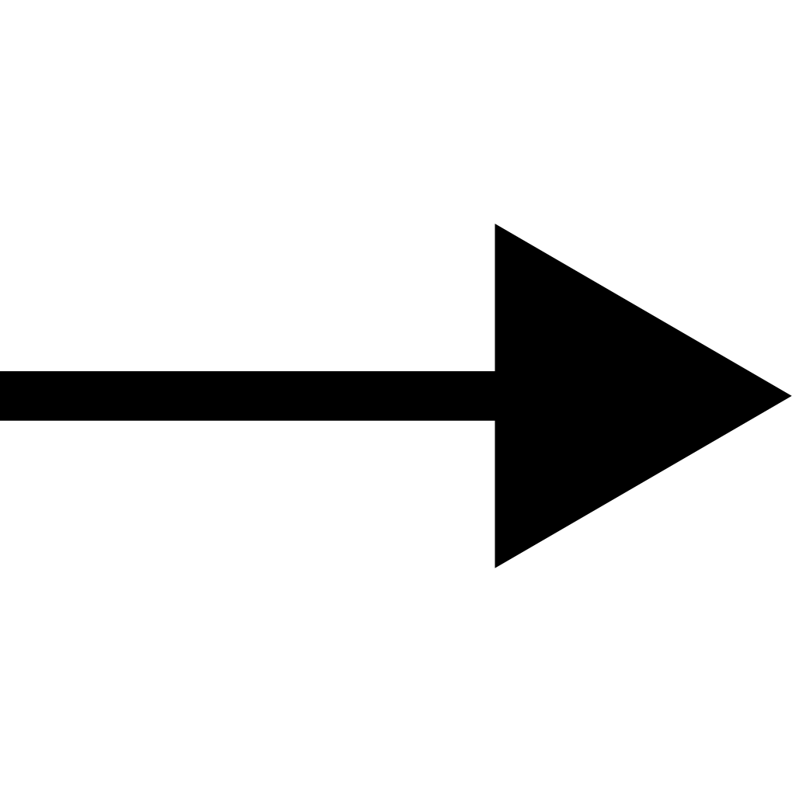
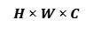
conv
conv
$$H×W$$
softmax
conv
DCN
Conv
concat
1X1Conv
$$H×W×C$$
$$H×W×C$$
Conv
1X1Conv
3X3Conv
1X1Conv
softmax
conv
$$H×W$$
1X1Conv
3X3Conv
3X3Conv
3X3Conv
concat
1X1Conv
5X5Conv
5X5Conv
3X3Conv
conv
Notes:
Added by @srvmshr
Sourav @ yahoo.com

Slide 21
A
softmax
$$H×W$$
1X1Conv
3X3Conv
1X1Conv
Conv
A
B
C
D
Conv
1X1Conv
3X3Conv
3X3Conv
3X3Conv
Conv
concat
1X1Conv
5X5Conv
5X5Conv
3X3Conv
Deformable Convolution
multiply
feature map
Conv Block
Connection Block
offset
Conv
concat
add
Notes:
Added by @srvmshr
Sourav @ yahoo.com

Slide 22
1X1Conv
$$H×W×C$$
$$H×W$$
1X1Conv
3X3Conv
1X1Conv
softmax
conv
conv
1X1Conv
3X3Conv
3X3Conv
3X3Conv
concat
$$H×W×C$$
1X1Conv
5X5Conv
5X5Conv
3X3Conv
conv
DCN
Notes:
Added by @srvmshr
Sourav @ yahoo.com

Slide 23
CONV operation
MxM
ReLU
+b1
+b1
MxMX2
+b2
+b2
NxNx3
MxM
ReLU
Notes:
Added by @srvmshr
Sourav @ yahoo.com

Slide 24
Abstract backgrounds
Notes:
Note:
You can add abstract backgrounds here

Slide 25
Depthwise Convolution
KxKconv
Pointwise Convolution
1x1conv
Notes:
Note:
You can add abstract backgrounds here

Slide 26
Abstract backgrounds
Notes:
Note:
You can add abstract backgrounds here

Slide 27
Notes:
Note:
You can change the gradient of each component
Author: Elvis Saravia

Slide 28
DAIR.AI
Notes:
Note:
This is the header I use for the dair.ai NLP Newsletter
You can change the gradient of each component
You can customize the background as well by right clicking and changing to another gradient or static color
Author: Elvis Saravia

Slide 29
Notes:
Note:
This is the header I use for the dair.ai NLP Newsletter
You can change the gradient of each component
Author: Elvis Saravia

Slide 30
Notes:
Note:
This is the header I use for the dair.ai NLP Newsletter
You can change the gradient of each component
Author: Elvis Saravia

Slide 31
Gradient Backgrounds
Notes:
Note:
Gradient background shows some inspirations and ideas for color themes that could be used for backgrounds
The examples used in this section are inspired by https://uigradients.com

Slide 35
Community Contributions
Notes:
Note:
You can add abstract backgrounds here

Slide 36
Striding in CONV
S=1
S=2
Notes:
Created by @srvmshr
Sourav @ yahoo.com

Slide 37
Notes:
Created by @srvmshr
Sourav @ yahoo.com

Slide 39
MaxPool Same s=1
Inception Module
5x5 Same
3x3 Same
NxNx192
1x1 Same
NxNx192
NxNx128
NxNx32
NxNx64
Notes:
Created by @srvmshr
Sourav @ yahoo.com

Slide 40
t-1
t
Retraining w/o expansion
Notes:
Note:
1 hidden layer neural network
Author: Elvis Saravia (ellfae@gmail.com)

Slide 41
No-Retraining w/ expansion
Partial Retraining w/ expansion
Notes:
Note:
1 hidden layer neural network
Author: Elvis Saravia (ellfae@gmail.com)

Slide 42
t-1
t
t-1
t
No-Retraining w/ expansion
Partial Retraining w/ expansion
Notes:
Note:
1 hidden layer neural network
Author: Elvis Saravia (ellfae@gmail.com)

Slide 43
t-1
t
t-1
t
t-1
t
Retraining expansion
No-Retraining expansion
Partial Retraining expansion
Notes:
Note:
1 hidden layer neural network
Author: Elvis Saravia (ellfae@gmail.com)

Slide 44
Size
Family?
X
Y
#bed
Walk?
PRICE ŷ
Basic Neuron Model
ZIP
School
How does NN work (Insprired from Coursera)
Wealth
Ŷ = 0
X
Logistic Regression
Ŷ = 1
Notes:
By @srvmshr
sourav@yahoo.com

Slide 45
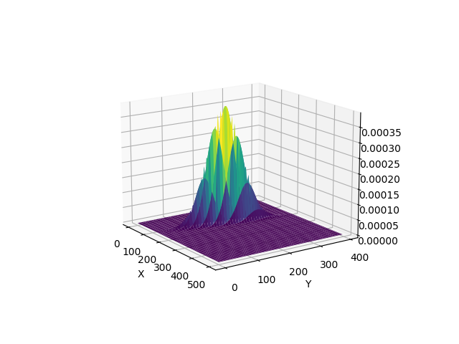
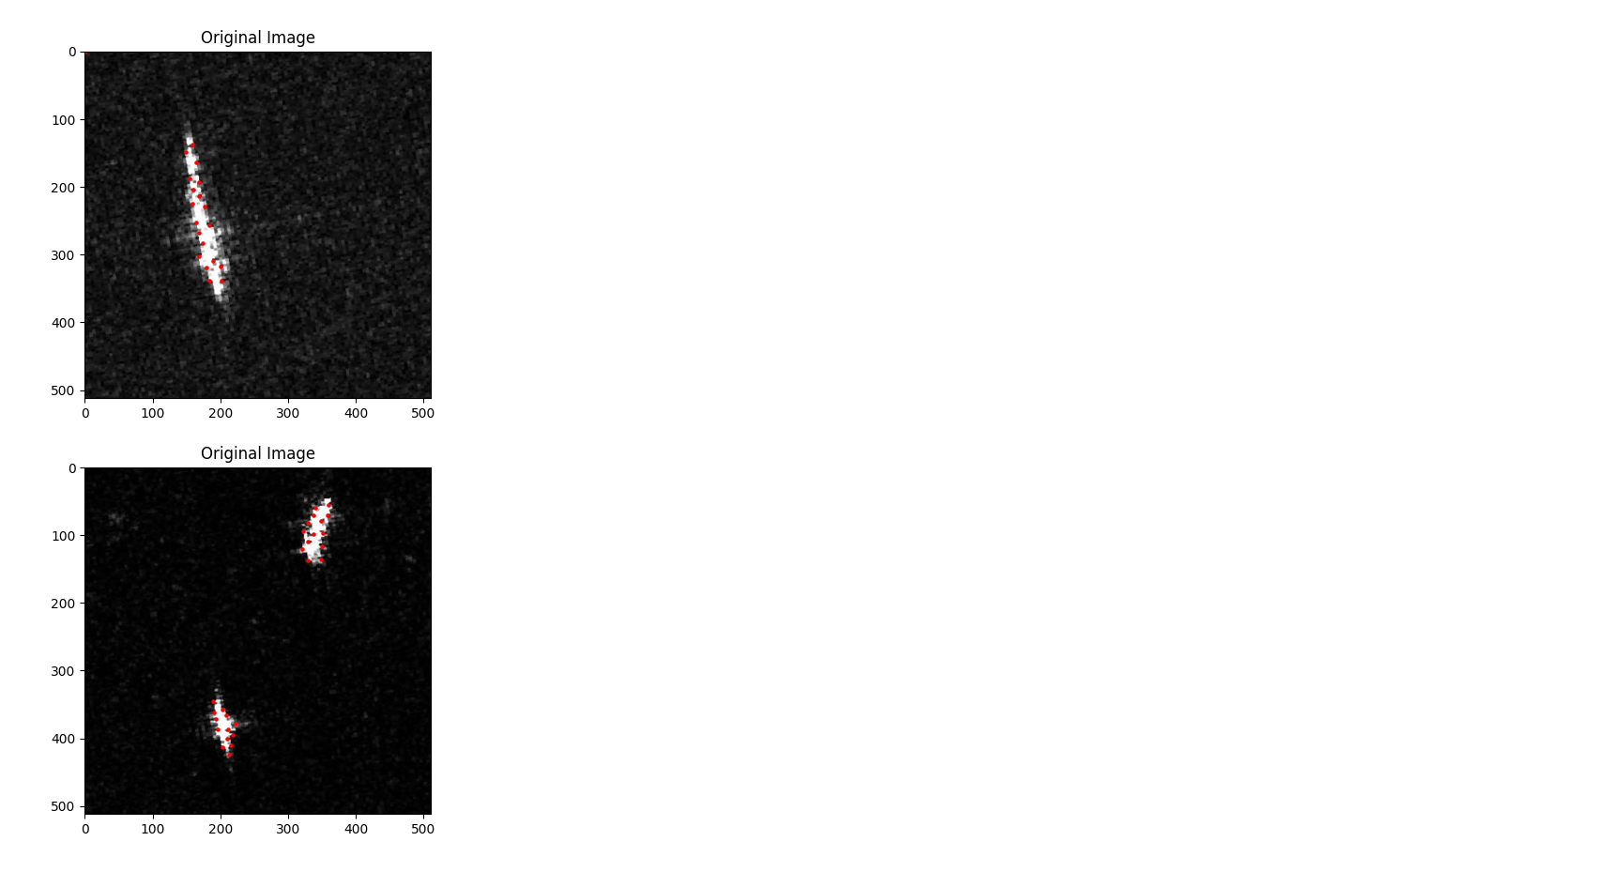
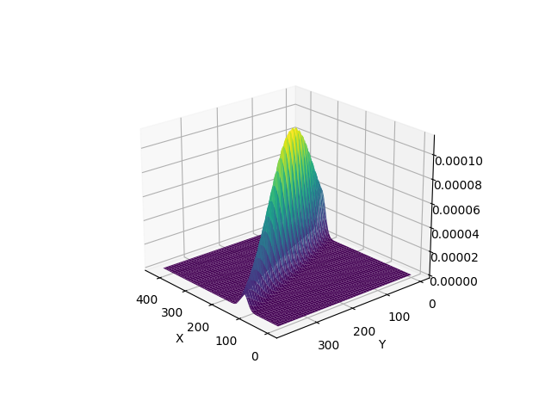
Notes:
By @srvmshr
sourav@yahoo.com

Slide 46
ReLU(x)
$
Size
Notes:
By @srvmshr
sourav@yahoo.com

Slide 47
Training
CONV
3
CONV
1
CONV
2
CONV
5
CONV
6
CONV
7
I
I1
CONV
4
128*128*1
128*128*1
Encoder
Decoder
Decoder
V1
V
ENcoder
128*128*1
128*128*1
Notes:
By @srvmshr
sourav@yahoo.com

Slide 48
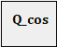
Scatter point
Scattering point group
Reppoints
$$Q_cos$$
Kmeans Clustering
Cosine similarity
select the max
Notes:
By @srvmshr
sourav@yahoo.com

Slide 49
Large NN
Med NN
η
Small NN
SVM,LR etc
Amount of Data
Why does Deep learning work?
Notes:
By @srvmshr
sourav@yahoo.com

Slide 50
Hidden
Input
Output
a^{[1]}₁
a^{[1]}₂
One hidden layer neural network
X
a^{[2]}
Ŷ
a^{[1]}₃
a^{[1]}₄
X = A^{[0]}
A^{[1]}
A^{[2]}
Notes:
By @srvmshr
sourav@yahoo.com

Slide 51
a^{[1]}₁
x_{[1]}
a^{[2]}
a^{[1]}₂
x_{[2]}
x_{[1]}
x_{[2]}
x_{[3]}
Neural network templates
Notes:
By @srvmshr
sourav@yahoo.com

Slide 52
a^{[1]}₁
x_{[1]}
a^{[2]}
a^{[1]}₂
x_{[2]}
x_{[1]}
x_{[2]}
x_{[3]}
Neural network templates
Notes:
By @srvmshr
sourav@yahoo.com

Slide 53
Train
Valid
Test
Underfitting
Good fit
Overfitting
x2
x2
x2
x1
x1
x1
Train-Dev-Test vs. Model fitting
Notes:
By @srvmshr
sourav@yahoo.com

Slide 54
x_{[1]}
x_{[2]}
a_{[L]}
DropOut
x_{[3]}
x2
r=1
x2
Normalization
x1
x1
Notes:
By @srvmshr
sourav@yahoo.com

Slide 55
x_{[1]}
x_{[2]}
a_{[L]}
DropOut
x_{[3]}
y
y
x1
x1
Notes:
By @srvmshr
sourav@yahoo.com

Slide 56
J
w2
Early stopping
w1
w1
w2
Before Normalization
J
w2
$$2$$
$$4$$
$$6$$
$$8$$
w1
w1
After Normalization
w2
Notes:
By @srvmshr
sourav@yahoo.com

Slide 57
x₁
x₂
w[L]
w[1]
w[2]
w[L-2]
w[L-1]
Deep neural networks
FN
TN
TP
FP
Understanding
Precision & Recall
Notes:
By @srvmshr
sourav@yahoo.com

Slide 58
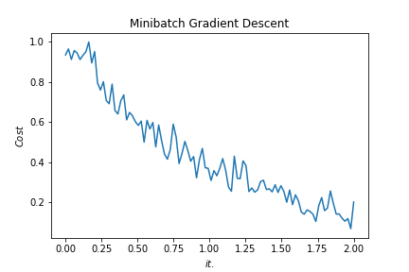
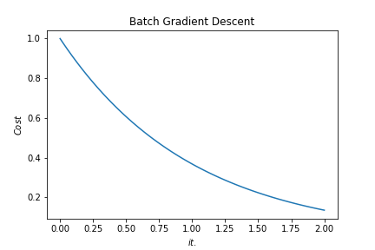
Batch vs. Mini-batch Gradient Descent
w2
w2
BGD
SGD
Batch Gradient Descent vs. SGD
SGD
w1
w1
Notes:
By @srvmshr
sourav@yahoo.com

Slide 59
x_{[1]}
p_{[1]}
x_{[2]}
p_{[2]}
x_{[3]}
Softmax Prediction with 2 outputs
Notes:
By @srvmshr
sourav@yahoo.com

Slide 60
Miscellaneous

Slide 61
16
16+32
16
16
1
3
Convolution 3x3
Convolution 1x1
Dropout 0.1
16
Max Pooling 2x2
Skip connection
Dropout 0.2
Up Sampling 2x2
Block copied
Dropout 0.3
32
32
32+64
32
64
64
64+128
64
128
128
128+256
128
256
256
Notes:
By @avsthiago

Slide 62
Softmax
FC
Layer4
Layer1
Layer2
Layer3
FC
Layer3
Max-Pool
Input
Output
Conv3-32
Conv3-32
Conv3-32
Conv3-32
Max-Pool
Conv3-64
Max-Pool
Conv3-128
Max-Pool
Conv3-64
FC-512
Conv
Layer2
Max-Pool
Conv
Layer1
Input
Layer1
Layer2
Layer3
Layer4
Conv3-32
Output
Conv3-32
Conv3-32
Conv3-32
Max-Pool
Conv3-64
Max-Pool
Conv3-128
Max-Pool
Conv3-64
FC-512
Notes:
By @avsthiago

Slide 63
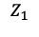
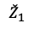
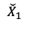
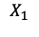
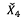
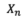
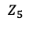
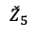
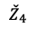
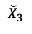
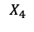
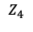
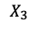
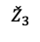
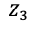
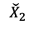
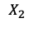
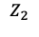
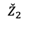
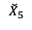
生成器
过滤器
判别器
编码器
解码器
$$X_{1}$$
$$Z_{1}$$
$${\check{Z}}_{1}$$
$${\check{X}}_{1}$$
Linear
Transformer Block
Transformer Block
$$X_{2}$$
$$Z_{2}$$
$${\check{Z}}_{2}$$
$${\check{X}}_{2}$$
Linear
训练阶段
Transformer Block
Transformer Block
Linear
$$X_{3}$$
$$Z_{3}$$
$${\check{Z}}_{3}$$
$${\check{X}}_{3}$$
$$X_{4}$$
$$Z_{4}$$
$${\check{Z}}_{4}$$
$${\check{X}}_{4}$$
Linear
Transformer Block
Transformer Block
$$X_{n}$$
$$Z_{5}$$
$${\check{Z}}_{5}$$
$${\check{X}}_{5}$$
Linear
双向交互注意力模块
生成器
入侵检测
编码器
解码器
均方误差（异常分数）
Transformer Block
Transformer Block
异常分数>阈值
测试阶段
Transformer Block
Transformer Block
正常
异常
Transformer Block
Transformer Block
Notes:
By @avsthiago

Slide 64
Filter concatenation
3x3 convolutions
5x5 convolutions
1x1 convolutions
1x1 convolutions
1x1 convolutions
1x1 convolutions
3x3 max pooling
Previous layer
Notes:
By @avsthiago

Slide 65
Previous layer
1x3 conv,
1 padding
1x3 conv,
1 padding
1x7 conv,
3 padding
1x3 conv,
1 padding
1x5 conv,
2 padding
1x3 conv,
1 padding
Filter concatenation

Slide 66
Avg-Pool
Auxiliary Classifier
Conv
FC
FC
Softmax
Inception
Input
Inception
Conv
Max-Pool
Conv
Max-Pool
Conv
Max-Pool
Inception
Inception
Max-Pool
Inception
Inception
Inception
Inception
Inception
Max-Pool
Avg-Pool
Conv
FC
Softmax
Avg-Pool
Auxiliary Classifier
Conv
FC
FC
Softmax
Input
ConvTranspose2d
Max-Pool
Conv
Max-Pool
Notes:
By @avsthiago

Slide 67
Filter concatenation
Filter concatenation
3x3 conv.
1x3 conv.
3x1 conv.
1x1 conv.
3x3 conv.
3x3 conv.
1x1 conv.
1x3 conv.
3x1 conv.
3x3 conv.
1x1 conv.
1x1 conv.
Pool
1x1 conv.
1x1 conv.
Pool
1x1 conv.
1x1 conv.
Previous layer
Previous layer
(a)
(b)
Notes:
By @avsthiago

Slide 68
Previous input
Previous input
x
x
F(x)
F(x)
Stacked layers
Stacked layers
x
identity
+
y=F(x)
y=F(x)+x
R1
R1
R2
R1
R1
R2
R3
R1
R2
R3
Notes:
By @avsthiago

Slide 69
Dense Block 1
Dense Block 2
Dense Block 3
Softmax
FC
Avg-Pool
Avg-Pool
Conv
Conv
Input
Avg-Pool
Conv
Transition layers
Notes:
By @avsthiago

Slide 70
h_{i+1}
Filter concatenation
h_{i+1}
add
add
Filter concatenation
3x3 max
3x3 conv
3x3 avg
identity
add
add
add
add
add
add
add
add
3x3 conv
identity
3x3 conv
5x5 conv
3x3 avg
identity
3x3 avg
3x3 avg
3x3 conv
5x5 conv
7x7 conv
5x5 conv
3x3 max
7x7 conv
3x3 avg
5x5 conv
h_{i}
h_{i}
...
...
h_{i-1}
h_{i-1}
(a)
(b)
Notes:
By @avsthiago

Slide 71
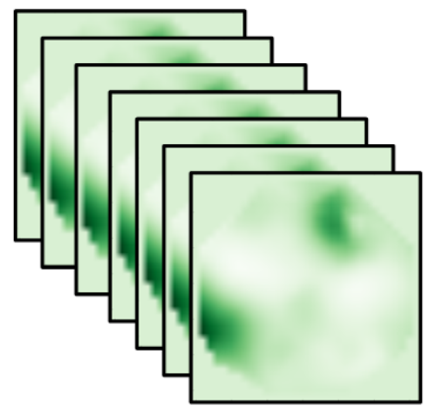
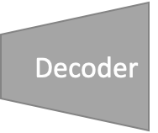
=
14*14
28*28
56*56
112*112
224*224
Notes:
By @avsthiago

Slide 72
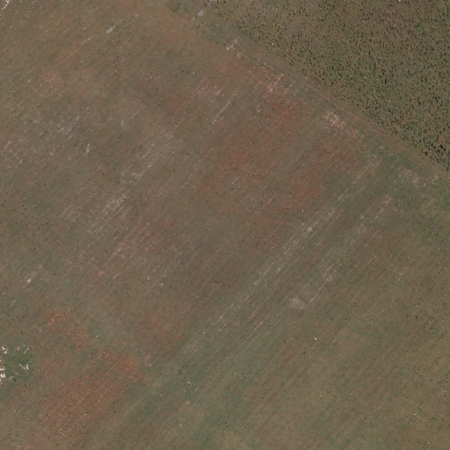
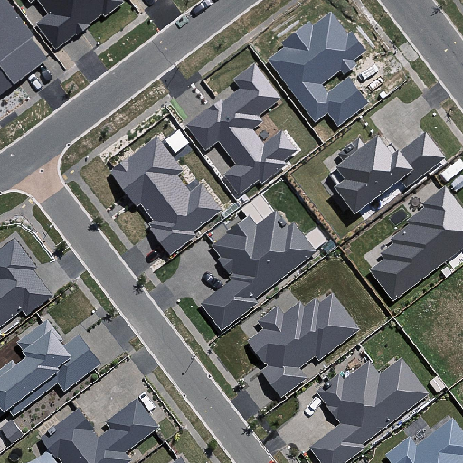
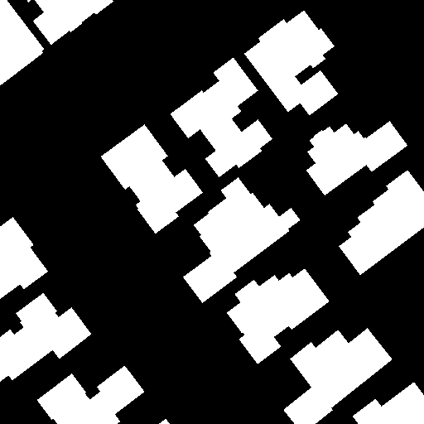
1/2
1/4
1/8
1/16
1/16
Encoder
影像A
1X1 Conv
ASPP
3X3 Conv
Rate 6
MSDAF
MSDAF
MSDAF
MSDAF
Conv
3X3 Conv
Rate 12
Conv
权重共享
3X3 Conv
Rate 18
影像B
Image Pooling
Decoder
Upsampleby2
Conv
HCF-IF
Upsampleby2
HCF-IF
Conv
Upsampleby2
HCF-IF
CRF
Conv
Conv
Notes:
By @avsthiago

Slide 73
stream1
Conv
stream2
Conv
stream2
Conv
ERM
Conv
δ
ERM
Notes:
By @avsthiago

Slide 74
stream1
Conv
stream2
Conv
stream2
Conv
ERM
Conv
δ
ERM
Notes:
By @avsthiago

Slide 75
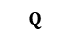
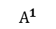
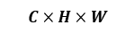
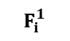
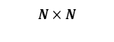
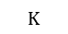
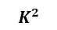
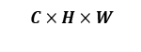
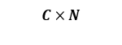
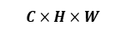
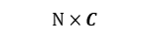

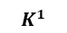


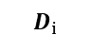
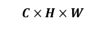
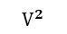
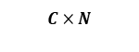
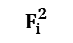



$$V$$
$$V^{1}$$
$$F_{i}^{1}$$
Reshape
Reshape
$$C×H×W$$
$$C×N$$
$$C×N$$
$$C×H×W$$
Conv
$$K$$
$$K^{1}$$
Reshape
$$C×N$$
$$A^{1}$$
$$C×H×W$$
$$C×H×W$$
$$D_{i}$$
S
$$Q$$
$$N×N$$
Concat
Conv
Conv
Reshape
Tranpose
$$N×N$$
$$C×H×W$$
$$C×H×W$$
$$N×C$$
$$C×H×W$$
S
$$K$$
$$A^{2}$$
$$F_{i}^{2}$$
$$C×H×W$$
Reshape
$$C×N$$
$$K^{2}$$
相乘
Conv
卷积
Conv
$$C×H×W$$
$$C×N$$
$$V$$
Reshape
Reshape
相加
Concat
拼接
$$C×H×W$$
$$V^{2}$$
S
Softmax
$$C×N$$
$$C×H×W$$
Notes:
By @avsthiago

Slide 76
stream1
Conv
stream2
Conv
stream2
Conv
ERM
Conv
δ
ERM
Notes:
By @avsthiago

Slide 77








stream1
Conv
stream2
Conv
stream2
Conv
$$F_{i}^{1}$$
ERM
$$F_{i}^{1}$$
$$R_{i}^{1}$$
$$W_{i}^{1}$$
$$S_{i}$$
DAM
Conv
δ
Conv
DFRM
$$W_{i}^{2}$$
$$R_{i}^{2}$$
$$F_{i}^{2}$$
ERM
$$F_{i}^{2}$$
ERM
DAM
DFRM
边缘细化模块
差分对齐模块
差分特征细化模块
差分
δ
Sigmoid
相加
相乘
Notes:
By @avsthiago

Slide 78
stream1
Conv
stream2
Conv
stream2
Conv
$$F_{i}^{1}$$
EFREM
$$F_{i}^{1}$$
$$R_{i}^{1}$$
$$W_{i}^{1}$$
Conv
δ
DAM
Conv
DIAM
$$W_{i}^{2}$$
$$R_{i}^{2}$$
$$F_{i}^{2}$$
EFREN
$$F_{i}^{2}$$
EFREM
DAM
DIAM
Conv
边缘细化模块
差分对齐模块
差分交互注意力模块
卷积
δ
Sigmoid
相加
相乘
差分
Notes:
By @avsthiago

Slide 79









Conv
Conv
Conv
$$L$$
$$F_{i}$$
Conv
$$W_{i}$$
Concat
Conv
S
Concat
$$G_{x}$$
$$\sqrt{G_{X}+G_{y}}$$
$$G_{i}$$
$$G_{y}$$
Concat
Conv
拉普拉斯核卷积
${Sobel}_{x}$核卷积
${Sobel}_{y}$核卷积
拼接
卷积
S
Softmax激活函数
相加
相乘
Notes:
Added by @srvmshr
Sourav @ yahoo.com

Slide 80





Conv
Conv
Conv
$$L$$
$$F_{i}$$
Conv
$$W_{i}$$
Concat
Conv
S
Concat
Conv
$$G_{x}$$
$$\sqrt{G_{X}+G_{y}}$$
$$G_{i}$$
$$G_{y}$$
Concat
Conv
拉普拉斯核卷积
${Sobel}_{x}$核卷积
${Sobel}_{y}$核卷积
拼接
卷积
S
Softmax激活函数
相加
相乘
Notes:
Added by @srvmshr
Sourav @ yahoo.com

Slide 81
Notes:
By @avsthiago
Dark-theme version of the previous (by Elvis Saravia)

Slide 82




1
1
2
Max(1,1,5,6) = 6
5
6
7
4
3
2
1
8
0
Pooling performed with a 2x2 kernel and a stride of 2
1
2
3
4
Notes:
By @avsthiago

Slide 83







编码器
ASPP
数据流
1X1 Conv
DCNN
3X3 Conv
Rate 6
3X3 Conv
Rate 12
WFEEM
输入影像
3X3 Conv
Rate 18
1X1Conv
WFEEM
Image Pooling
解码器
Upsample
By 4
1X1Conv
Concat
FA-FeNet
3X3 Conv
Upsample
By 4
预测结果
DCNN
Stage1
Stage2
Stage3
Stage3
Stagen
Input
Output
Conv Block
ID Block
Conv Block
ID Block
Conv Block
ID Block
Conv Block
Batch Norm
ID Block
ReLu
Conv
Maxpool
Notes:
By @avsthiago

Slide 84












R
G
B
LPF
LL
LPF
HPF
LH
X
LPF
HL
HPF
HPF
HH
Notes:
By @avsthiago

Slide 85


1x1 conv
Softmax
w1
1x1 conv.
3x3 conv
Softmax
w2
批归一化
5x5 conv
Softmax
w3
Relu激活
$$C×H×W$$
2x2 WTF
上采样插值
$$C×H×W$$
4x4 WTF
上采样插值
WTF
小波变换模块
wi
自适应学习权重
conv
卷积模块
相乘
相加
数据流
Notes:
By @avsthiago

Slide 86
1x1 conv.
Softmax
w1
1x1 conv.
3x3 conv.
Softmax
w2
层归一化
5x5 conv.
Softmax
w3
X
1x1 conv.
2x2 WTF
上采样插值
4x4 WTF
上采样插值
LPF
A
LPF
HPF
V
X
小波增强上下文学习网络
LPF
H
HPF
HPF
D
Notes:
By @avsthiago

Slide 87













$${F∈R}^{C×H×W }$$
$${F∈R}^{C×H×W }$$
Front
3X3 Conv
AvgPool+FC
Softmax
$${F∈R}^{1×H×W }$$
1X1Conv
1X1Conv
Split
Concat
1X1Conv
Split
Concat
$${F∈R}^{1×H×W }$$
$${F∈R}^{C×H×W }$$
$${F∈R}^{1×H×W }$$
$${F∈R}^{C×H×W }$$
$${F∈R}^{C×H×W }$$
AvgPool+FC
5X5 Conv
Back
Softmax
$${F∈R}^{C×H×W }$$
逐像素相乘
$${F∈R}^{C×H×W }$$
逐通道相乘
Notes:
By @avsthiago

Slide 88








影像
标签
WHU
INRIA

Slide 89


















影像A
影像B
Label
WHU-CD
LEVIR-CD

Slide 90



































图像
标签
UNET
PSPNET
MMBNET
DHINET
Deeplabv3+
Our_Method

Slide 91






影像
标签
添加FA-FeNet前
添加FA-FeNet后

Slide 92

真值
漏检
虚警
类比区域
影像
标签
添加WFEEM前
添加WFEEM后

Slide 93










16
19
1x1 conv.
Softmax
w1
1x1 conv.
14
3x3 conv.
Softmax
w2
层归一化
5x5 conv.
Softmax
w3
44
X
1x1 conv.
48

Slide 94










$${S_{1}∈R}^{C×H×W }$$
1x1 conv
Softmax
w1
$$A_{1}$$
$${S_{3}∈R}^{C×H×W }$$
$${S_{union}∈R}^{C×H×W }$$
1x1 conv
3x3 conv
Softmax
w2
$$A_{2}$$
$${S_{5}∈R}^{C×H×W }$$
批归一化
5x5 conv
Softmax
w3
$${F_{input}∈R}^{C×H×W }$$
$$A_{3}$$
$${F_{out}∈R}^{C×H×W }$$
Relu
$${F_{union}∈R}^{C×H×W }$$

Slide 95



$$F_{low}$$
Skip Connection
Low_level
Fuse_feature
DGA
Conv
High_level
$$F_{fuse}$$
$$F_{high}$$
Skip Connection

Slide 96
$$F_{low}$$
Skip Connection
Low_level
Fuse_feature
HGA
Concat
Conv
Conv
High_level
$$F_{fuse}$$
$$F_{high}$$
Skip Connection
HGA
Conv
层次增益注意力
相加
相乘
卷积

Slide 97




HCA
AVGP
MAXP
Conv1
HSA
Conv2
FC
FC
HGA
S
S
C
C
S
Sigmoid
C
相乘
Channel Shuffle
相加
S

Slide 98















T0影像
T1影像
（a）
（d）
（g）
T0影像
T1影像
（b）
（e）
（h）
T0影像
T1影像
图像
（c）
（f）
（i）

Slide 99
T0影像
T1影像
（a）
（c）
（e）
T0影像
T1影像
图像
（b）
（d）
（f）

Slide 100




































T0影像
T1影像
T0影像
T1影像
T0影像
T1影像
T0影像
T1影像
图像
标签
（a）
（b）
（c）
（d）
（e）
（f）

Slide 101










真值
T0影像
漏检
T1影像
虚警
类比区域
（a）
（c）
（e）
T0影像
T1影像
图像
（b）
（d）
（f）

Slide 102










真值
T0影像
漏检
T1影像
虚警
类比区域
（a）
（c）
（e）
T0影像
T1影像
图像
（b）
（d）
（f）

Slide 103




































T0影像
T1影像
T0影像
T1影像
T0影像
T1影像
T0影像
T1影像
图像
标签
（a）
（b）
（c）
（d）
（e）
（f）

